Slide 1

Rock, Paper, Scissors Game
This presentation explores the development of a classic Rock, Paper, Scissors game using Python. Learn about the project's objectives, design, implementation, and testing processes.

Slide 2

Acknowledgment
Deepest gratitude to Mr. Aman Kumar for their guidance and support throughout the project. Special thanks to the university for providing the necessary resources and to my peers for their collaboration and constructive feedback.
Mr. Aman Kumar
University
For providing resources and facilities.
For invaluable guidance and mentorship.
Peers
For collaboration and feedback.

Slide 3
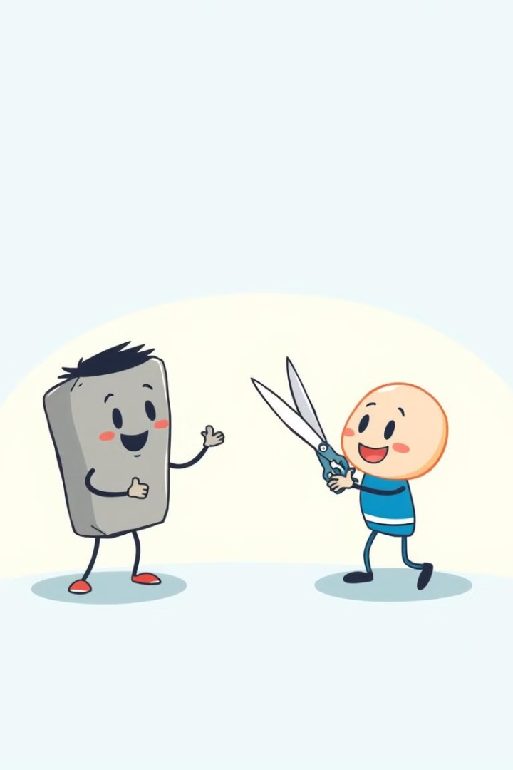
Introduction
The Rock, Paper, Scissors game is a popular choice for simple yet engaging gameplay. This project aims to create a digital version of the game using Python, incorporating user interaction and a graphical interface.
1
Gameplay
2
Interface
The classic rock, paper, scissors rules apply: Rock beats Scissors, Scissors beats Paper, and Paper beats Rock.
A user-friendly graphical interface allows players to select their choices and view the results.
3
Outcome
The program determines the winner based on player choices and displays the result, fostering interactive gameplay.

Slide 4
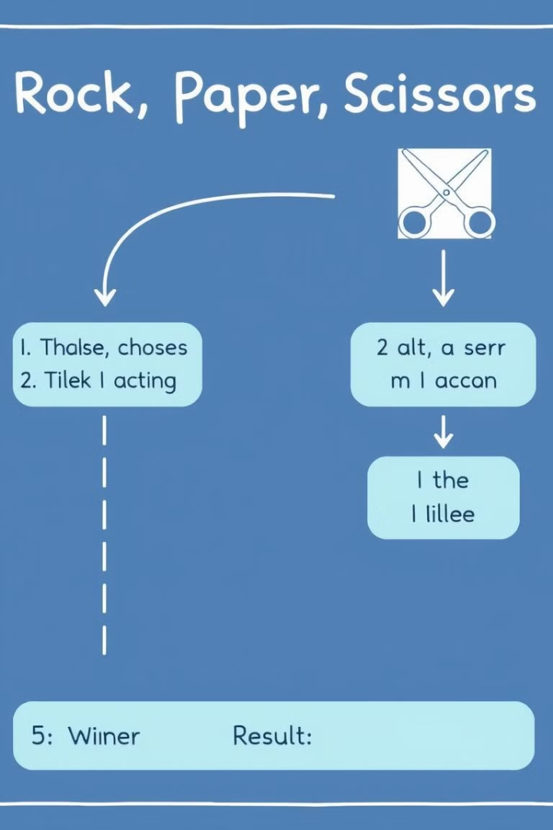
Objectives and Scope
This project aims to develop a functional Rock, Paper, Scissors game with a user-friendly interface and straightforward gameplay.
1
User Interaction
Allow users to select their choices through the interface.
2
Game Logic
Implement the game's logic to determine the winner based on choices.
3
Result Display
Display the outcome of each round, indicating the winner or a tie.

Slide 5
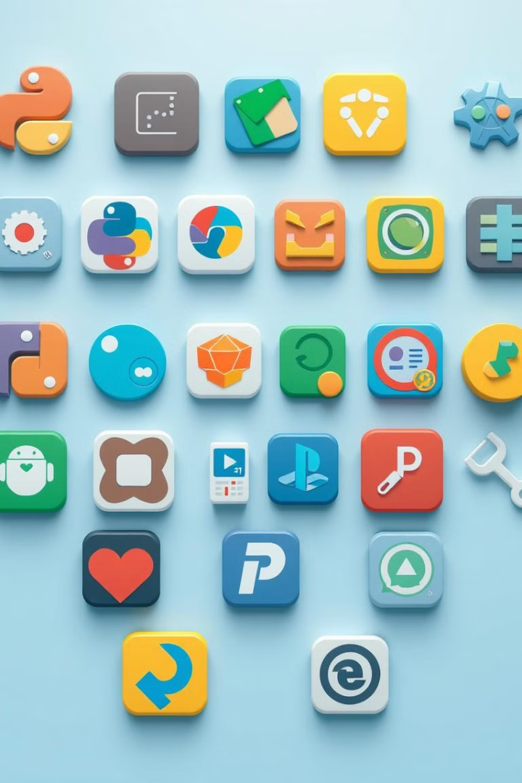
Application Tools
The project utilizes Python as the primary programming language, leveraging its libraries for graphical interface development, random number generation, and application packaging.
Programming Language
Python
GUI Library
tkinter
Random Number Generator
random
Application Packaging
PyInstaller

Slide 6
Project Design
The project follows a modular design, separating the game's functionality into distinct modules for enhanced organization and maintainability.
GUI Module
Logic Module
Control Module
Manages the user interface, providing buttons for choices and displaying results.
Implements the game's rules, determining the winner based on player choices.
Coordinates communication and data flow between the GUI and logic modules.

Slide 7
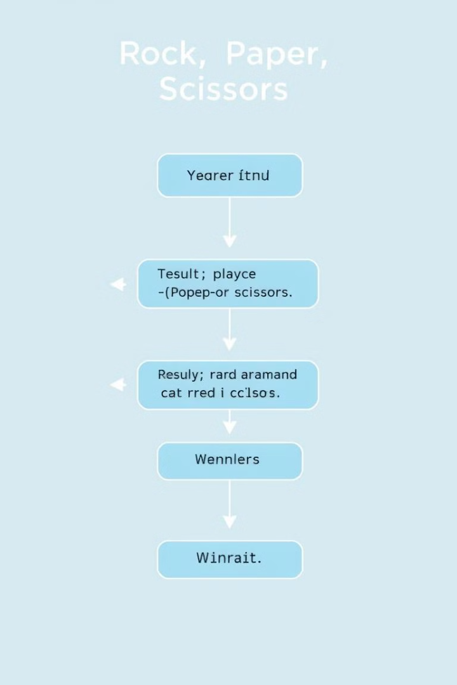




Flowchart
The flowchart visually represents the program's execution, outlining the steps involved in each round of the game.
User Input
The player selects their choice (Rock, Paper, or Scissors) using the GUI.
Computer Choice
The program generates a random choice for the computer opponent.
Winner Determination
The game logic determines the winner based on both choices.
Result Display
The winner or a tie is displayed on the GUI, providing feedback to the player.

Slide 8
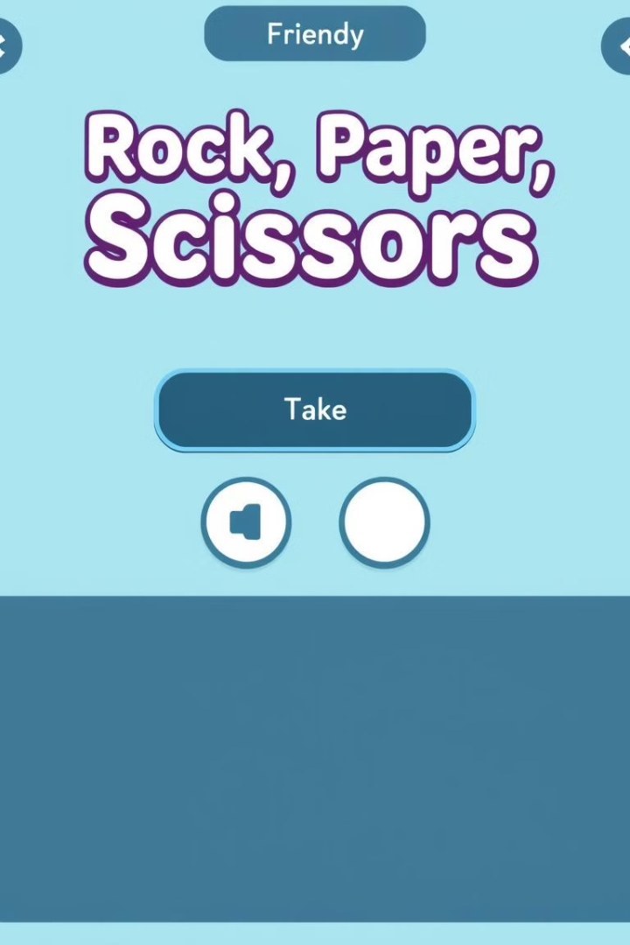
Implementation and Code Snippet
The game's logic is implemented through Python functions, including functions for handling user input, generating computer choices, and determining the winner.
def determine_winner(player_choice, computer_choice): if player_choice == computer_choice: return "Tie" elif (player_choice == "Rock" and computer_choice == "Scissors") or \ (player_choice == "Paper" and computer_choice == "Rock") or \ (player_choice == "Scissors" and computer_choice == "Paper"): return "Player wins" else: return "Computer wins"

Slide 9
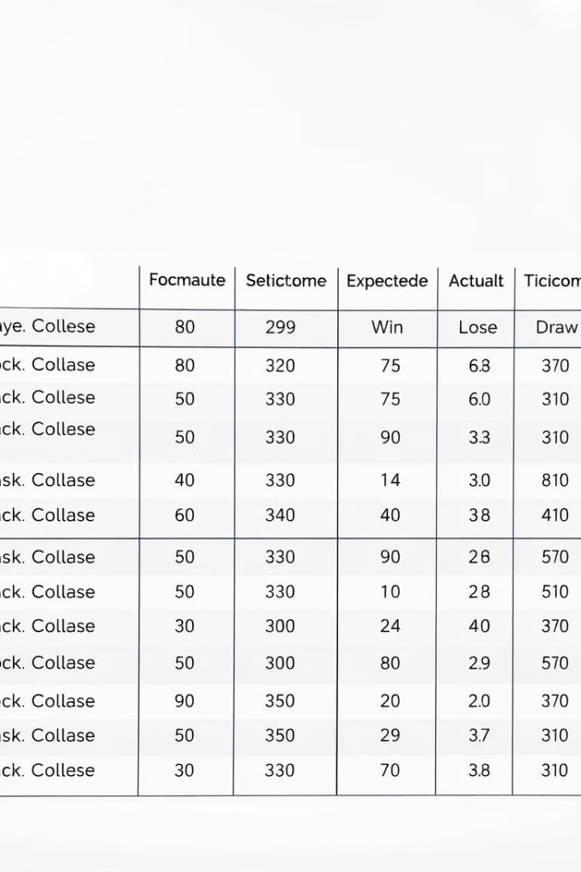
Testing and Validation
Extensive unit and system testing was conducted to ensure the game's functionality and accuracy.
Player Choice
Computer Choice
Expected Outcome
Actual Outcome
Rock
Scissors
Player wins
Player wins
Paper
Rock
Player wins
Player wins
Scissors
Paper
Player wins
Player wins
Rock
Rock
Tie
Tie

Slide 10
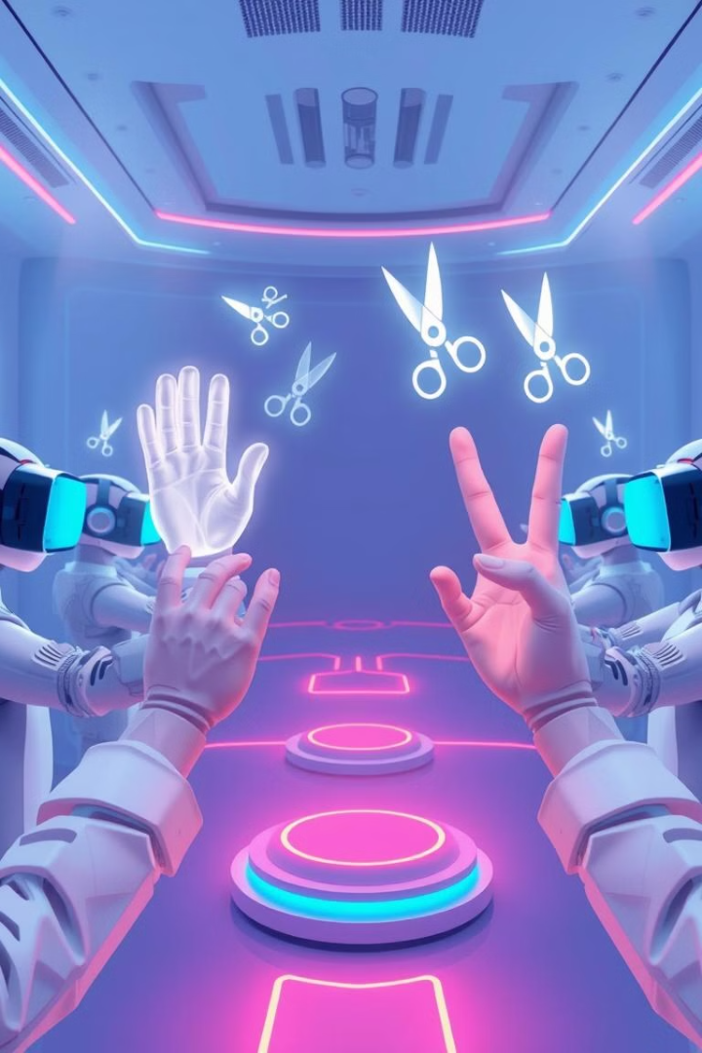



Conclusion and Future Scope
The project successfully developed a functional Rock, Paper, Scissors game with a user-friendly interface.
Multiplayer Mode
Allowing multiple players to compete against each other.
AI Opponent
Developing an AI opponent that learns and adapts to player strategies.
Advanced Graphics
Creating visually appealing graphics and animations to enhance gameplay.

